Slide 1
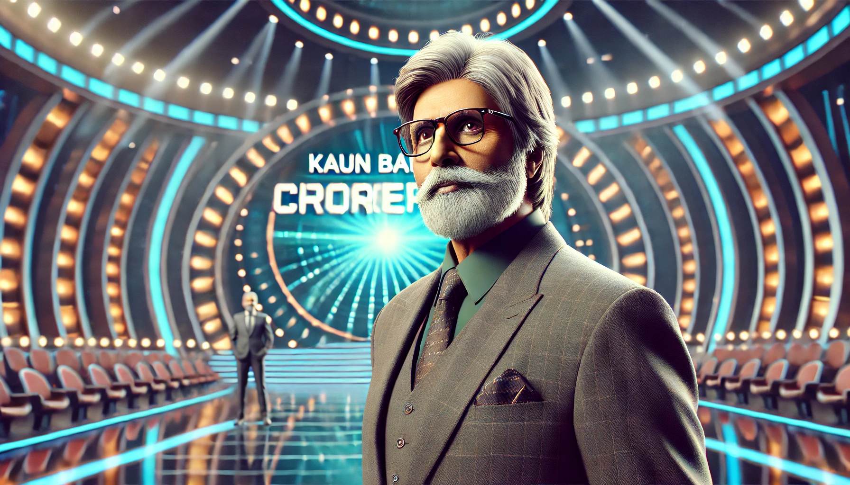
CYBERSCAPE 2K24/2024 KBC

Slide 2
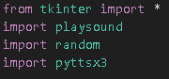
Packages used in python
The Packages used are :-
Tkinter
Random
Playsound
Pyttsx3
1

Slide 3
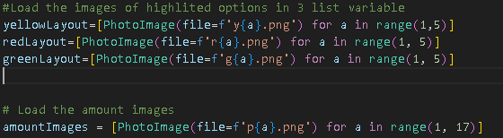
Image and Prize amounts
This displays all the images and displays the winnings earned by the player so far😁

Slide 4
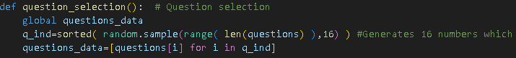
The select question
This select 16 random questions from the list of 40 questions.
So that the player may at least win one😅

Slide 5
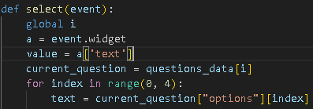
The option select
This displays which option is selected by the player to answer the
question, but this will not select the correct option automatically🙄

Slide 6
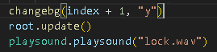
The option select background
This will change the background when the option is selected
May we could change the days and night like this too😇

Slide 7
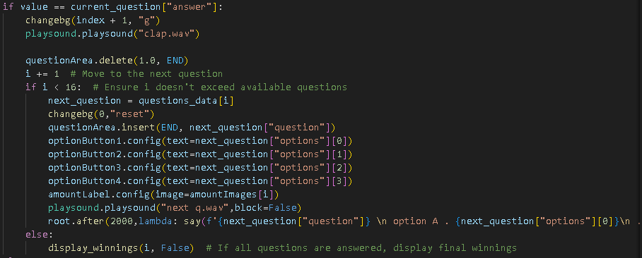
Will it be an update or an end?

Slide 8
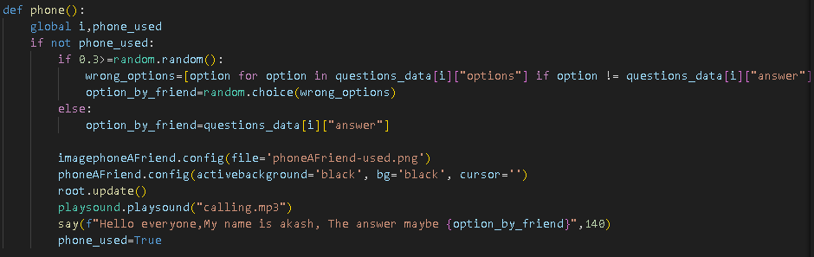
Phone a friend.
It calls Akash he will help you once, but be careful he might provide you with wrong answer too so don’t rely on it 🤔.(Just a warning take it seriously)

Slide 9
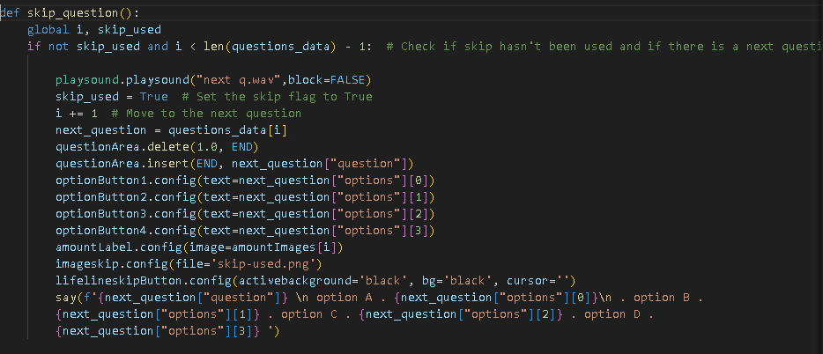
Skip the question.
It will skip the question like we do skip ads on social media websites right😏

Slide 10
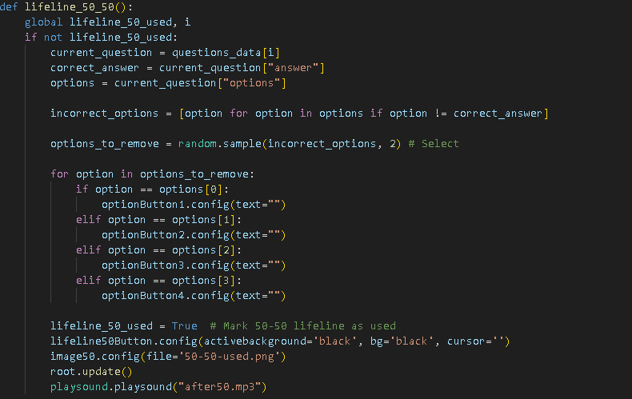
50-50 lifeline
This eliminates two wrong answers and leaves you with more confusion🧐

Slide 11
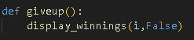
Gave up already?
This function quits the game like our hopes at our low's😫

Slide 12
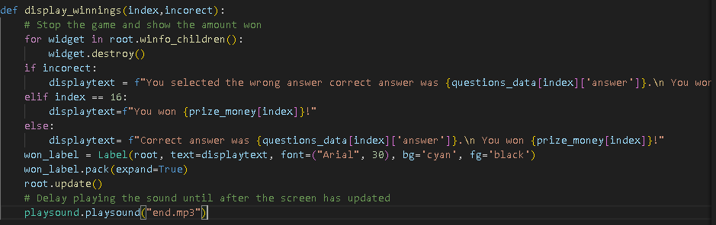
Display the winnings won by the player
This function displays the current time prize money won by the user on the scoreboard at the right hand side of the game just like in the real life show, classic right?

Slide 13
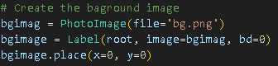
Background of the game
This function is used for altering the background of the game while the game is running😀

Slide 14
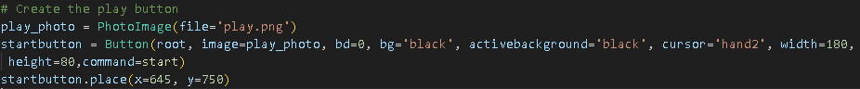
PLAY
BUTTON
You need to start the game right🙄
This will just create the play button

Slide 15

THANKING YOU
THANK YOU
BY:- Daksh Kamma
Devang Jaiswal
Arav Shaw
Zaid Bin Javed Ansari
UGLYstudent of class 9B

